Slide 1
Alexander The Great
By: Alexandra Newcomb, Destiney Silva, Angelina Falla

Slide 2
Alexander the Great
Alexander III of Macedon was also known as Alexander the great. He was the king of the Ancient Greek kingdom of Macedon. He was also a member of the Argead dynasty.

Slide 3
What was he known for?
Alexander the great was best known for conquering most of the western world about in the 4th century . At the age of 20 he assembled a force in greek cities and they called him their leader. He was determined to rule the world. He went through the south.

Slide 4
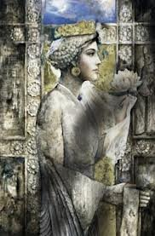
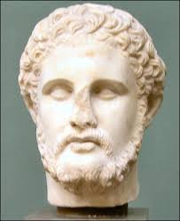
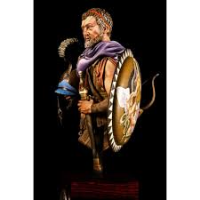
Family
Alexander the Great’s parent’s name was Philip II of Macedon and Olympias.
Alexander the Great had one child and his name was Alexander IV of Macedon.

Slide 5
Fun Facts
Alexander the Great was born around July 19/20 and it was about 356 B.C.
Alexander the Great had 3 wives
The First Wife’s Name: Roxane ( The mother of Alexander IV )
The Second Wife’s Name: Stateria
The Third Wife’s Name: Parysatis

Slide 6
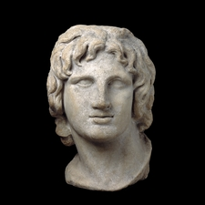
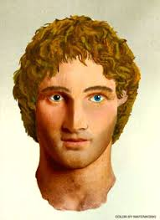
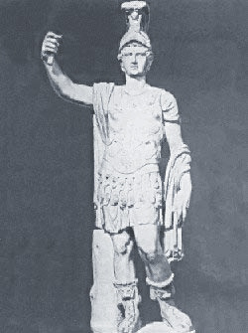
Here is some pictures of him!

Slide 7
Timeline
July 356 B.C.
Born by Philip II of Macedon and Olympias
336 B.C.
Alexander became the ruler of Macedonia
323 B.C.
Died in June
333 B.C.
Won the Battle of Issus against Darius
328 B.C.
He kills Cleitus for the insult at Samarkand

Slide 8
Bibliography
www.biography.com/people/alexander-the-great-9180468
http://www.bbc.co.uk/history/historic_figures/alexander_the_great.shtml

Slide 9
Any
Questions

Slide 10
THE
END

