Slide 1
Aristarchus
By: Macii Griego, Reanne Langevin, and Alexandra Newcomb

Slide 2
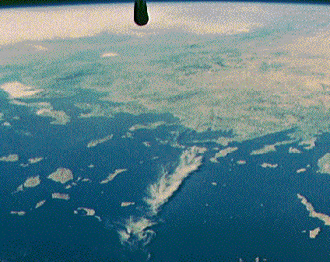
Life
Aristarchus was born 310 BC and Died 230 B.C. Aristarchus lived and was born on the Greek island of Samos, a small island in the center of the picture that is below.

Slide 3
What he did for a living
Aristarchus is a mathematician and an astronomer.
He stated ”... is a purely mathematical exercise which has ... little to do with practical astronomy …”. He was a scientific hero.

Slide 4
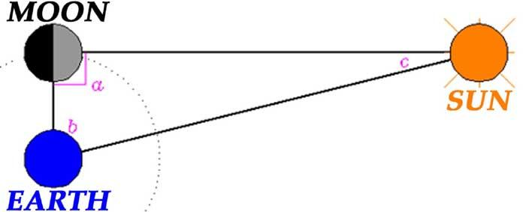
What he made
Aristarchus made the first model showing that the sun was in the middle of the universe. Here is a picture...

Slide 5
Here is an example of his model

Slide 6
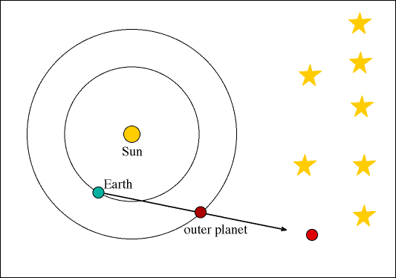

Slide 7
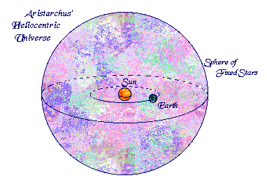
His model was called the Heliocentric Model.

Slide 8
Information
On the last slide was a diagram that Aristarchus made. It shows that all the planets orbit the sun. As the sun stays still, all of the planets are orbiting the sun, while the stars stay put in one place. The red and blue dots represent the planets orbiting and circling the sun.

Slide 9
Facts
Aristarchus wrote a scientific book about the heliocentric solar system. Sadly the book was lost before anybody had a chance to read it. He was one astronomer that used the concept of parallax. That is what showed that the stars were a long distance away from Earth. He believed Earth was rotating on it’s own axis. Aristarchus even tried to calculate the sizes of the moon and the sun. About 23 centuries ago, Aristarchus finally discovered that the Earth and the planets orbit the sun.

Slide 10
Bibliography
www.encyclopedia.com>...>Astronomy:Biographies
www.famousscientists.org/aristarchus/
www.astro.cornell.edu/academics/.../aristarchus.htm
www-history.mcs.st-and.ac.uk/Biographies/Aristarchus.html
www.varchive.org/ce/orbit/arisam.htm
www-history.mcs.st-and.ac.uk/Biographies/Aristarchus.html
www.historyforkids.org › Ancient Greece › Greek Science › Mathematics
www.ancient.eu/Aristarchus_of_Samos/

Slide 11
Thanks for Watching

