Slide 1
Mesopotamian Assyria + Government & Trade, Commerce
By: Alexandra Newcomb

Slide 2
What is Mesopotamia’s Assyria?
The Assyria is a group of people that are really war-like people. The people are called the Assyrians. They were known as great traders. The Assyrians traveled all over Mesopotamia. They had their own language and they worshiped the same gods as the people of Sumer and the Babylonians.They were nomadic warriors.

Slide 3
What is Mesopotamia’s Government?
Mesopotamian Government was a combination of monarchy and democracy. Kings were the ones who ruled the people and was the one who elected the officials. The officials also helped rule the people. There were four classes, there were The Priest, the Upper class, the Lower class, and the Slaves. The priests were the most powerful in government.

Slide 4
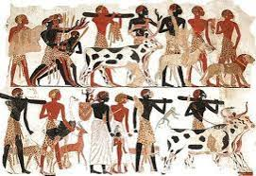
What is Mesopotamia’s Trade?
The Mesopotamians traded lots of animals, food, and tools. The Mesopotamians traded grains, oils, textiles, and wine. They traded the wine for mostly precious metals.

Slide 5
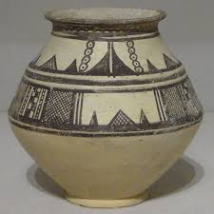
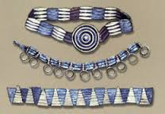
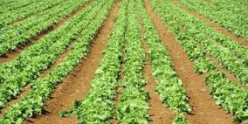
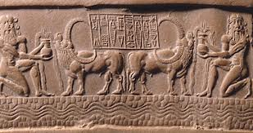
What is Mesopotamian Commerce?
Mesopotamians commerce is the activity of buying and selling. The mesopotamians bought and sold pottery, jewelry, food, animals, and stone masons.

Slide 6
After trading what did they use the stuff for?
After they traded the animals they had to use them as a form of transportation.

Slide 7
Why did they buy and sell?
They always bought tools and jewelry and etc. They sold to get more money to stay alive.

Slide 8
What did the Assyrians do for Mesopotamia?
The Assyrians protected Mesopotamia. They were very war - like people and would fight for Mesopotamia.

Slide 9
Bibliography
http://mesoptamia1.blogspot.com/2013/04/government.html
http://mesopotamia.mrdonn.org/assyria.html
http://www.mesopotamia.co.uk/trade/home_set.html
http://mesopotamia.mrdonn.org/commerce.html

Slide 10
Questions
Who are the Assyrians?
What did the Mesopotamians trade?
What was commerce to the Mesopotamians?
4. What was the combination of government?
5. What was one thing that the Mesopotamians sold?
A group of people
Animals, Food, and Tools
Buying and Selling
Monarchy and Democracy
Jewelery

